Slide 1
Reading Elective Presentation - III
By : Munagala Kalyan Ram

Slide 2
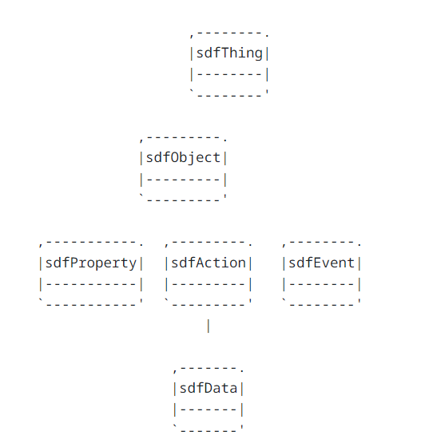
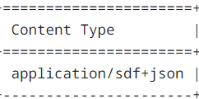
OneDM SDF (Semantic Definition Format)[Link]
The objective of OneDm is to create a common data model for IOT devices called SDF.
SDF makes use of the existing JSON features and adds upon it. They define a set of standard semantics in their format like sdfObject, sdfThing, namespaces, etc.
It provides a method for Things to describe their affordances, i.e properties, actions and events. This is done by using the key’s sdfProperty, sdfAction and sdfEvent.
The image shows the hierarchy that is followed to describe the Thing. It allows to describe a collection of Things and the objects it contains

Slide 3
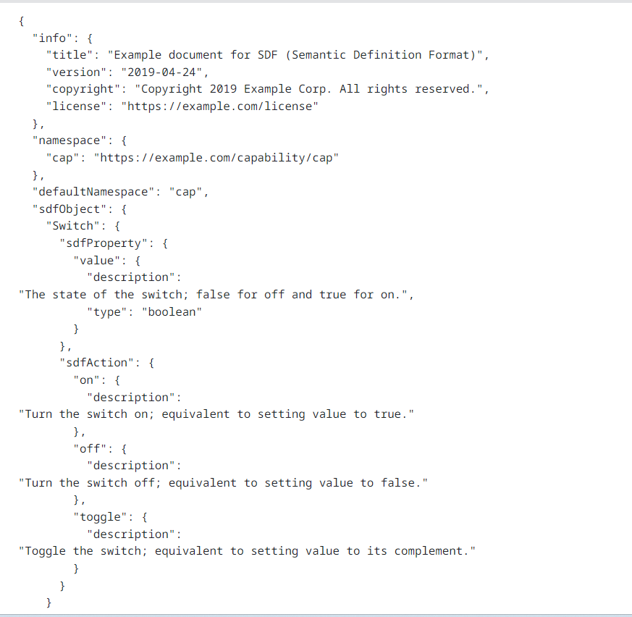
SDF [Link2]
This is the description of a toggle button with a description of its affordances using the SDF data model.
In this example, the info key has some generic meta data like title, description, version, license, etc.
The namespace key is a map from short names to the URI of the thing.
Inside the sdfObject key, we define a map of objects present on the Thing and inside each object description we specify the properties in sdfProperty and actions in sdfAction.

Slide 4
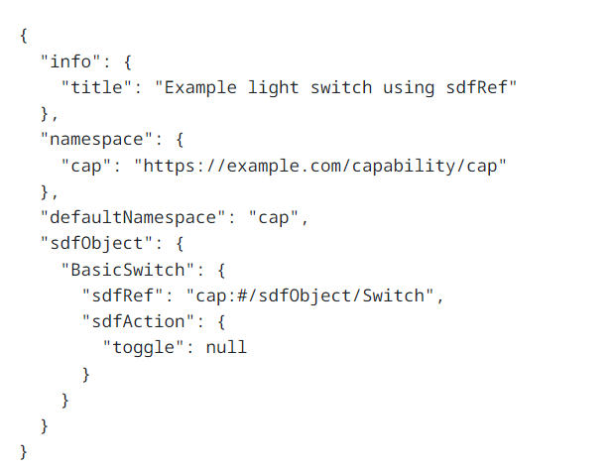
SDF [Link2]
Another key feature of SDF is the ability to reuse the object definitions by using the sdfRef key.
In this example we can see that the value of the sdfRef key is pointing to the Switch object from the previous example.
So now the BasicSwitch object has all the affordances of the Switch object. We can then add more affordances or remove them by setting the property or action to null.
It is similar to the inheritance concept in OOPS.

Slide 5
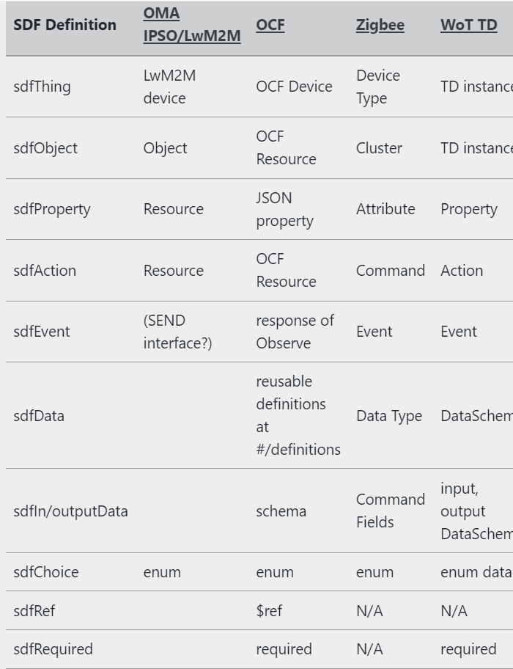
The official website provides a github repo to a bunch of examples of various objects like barometer, blood pressure, clock, gyrometer, etc in the SDF format : https://github.com/one-data-model/playground/tree/master
This data model came after JSON-LD and was created by the participation of various organizations like WOT, IPSO, OCF, etc.
The website also provides toolkits to convert from IPSO to SDF and vice versa. Also available for OCF (a format to provide a rest full description of resources) https://github.com/EricssonResearch/ipso-odm/tree/master
This format is well suited for IOT device descriptions particularly in constrained environments.

Slide 6
Experimenting and Implementations
For real world WOT applications, there have been 2 projects that have made some progress in implementing the abstract ideas of WOT , i.e Mozilla WebThings and Eclipse.
This article https://www.infoq.com/articles/web-of-things-iot-apps/ describes how to use Mozilla’s WebThing gateway to connect to a Thing (Raspberry Pi) and use an web interface to interact with the Thing.
However the links provided in the article to setup and run this gateway aren’t working anymore.
The other project which has made great progress is Eclipse ThingWeb https://projects.eclipse.org/projects/iot.thingweb
This project provides github codes for the following :
node-wot: Components for building IoT devices or for interacting with them over various IoT protocols
playground: Thing Description (TD) and Thing Model (TM) validation and manipulation
Online Things: Simulated IoT devices to test different IoT protocols

Slide 7
Trying out the simulated IOT devices : http://plugfest.thingweb.io/webui/
We can use the node-wot github code to create our own simulated IOT devices which we can interact with using the WOT TD.
Example of Smart Coffee Machine using the Node-wot API : https://www.thingweb.io/smart-coffee-machine.html
If we look at the data returned by the simulated thing, it is in the JSON-LD format. http://plugfest.thingweb.io:8083/testthing
The Eclipse organisation is also working on various other projects that use the concepts we have come across like using COAP as the application layer protocol, simulating an LwM2M server, etc.
Youtube Link of connecting to a microcontroller running as a LwM2M server : LwM2M Tutorial
Official website : Live Objects
Deployed Github Repo : https://leshan.eclipseprojects.io/#/clients
Code to the simulated LwM2M servers : https://github.com/eclipse-leshan/leshan/tree/f23254c85928bf0eba54c10b515b36ef050a6959

